Slide 1
CLOUDERA DATA PLATFORM Test Drive Workshop
Jan, 20 , 2022
Welcome! We will begin promptly at 10:05 AM IST

Slide 2
WELCOME TO THE CDP TEST DRIVE WORKSHOP!
We’re glad you are joining us to get hands-on experience with CDP
Session will be 2 hours
As you wait, please confirm your access to the CDP Test Drive via the credentials that were emailed to you, and provided below:
Link to Login: https://trycdp.com/lease/credentials/efa5235244cd9ac6e9bce8eed6a5f675524a9f2c0af6973e4b3673b8fb17c70e
email: ajose@cloudera.com
If you have any issues, please let us know via the chat
We will begin the presentation at 10:05 am IST

Slide 3
HOUSEKEEPING RULES
This session will be recorded
Please help mute your microphone
If you’d like to ask a question, please use the Chat function.
All links will be shared via chat

Slide 4

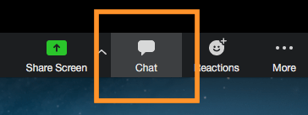
ZOOM MEETING: CHAT
From George Kuruvilla
Chat Feature
Hello World
The Chat function is a public chat feature so please use this to type in any question you might have.

Slide 5

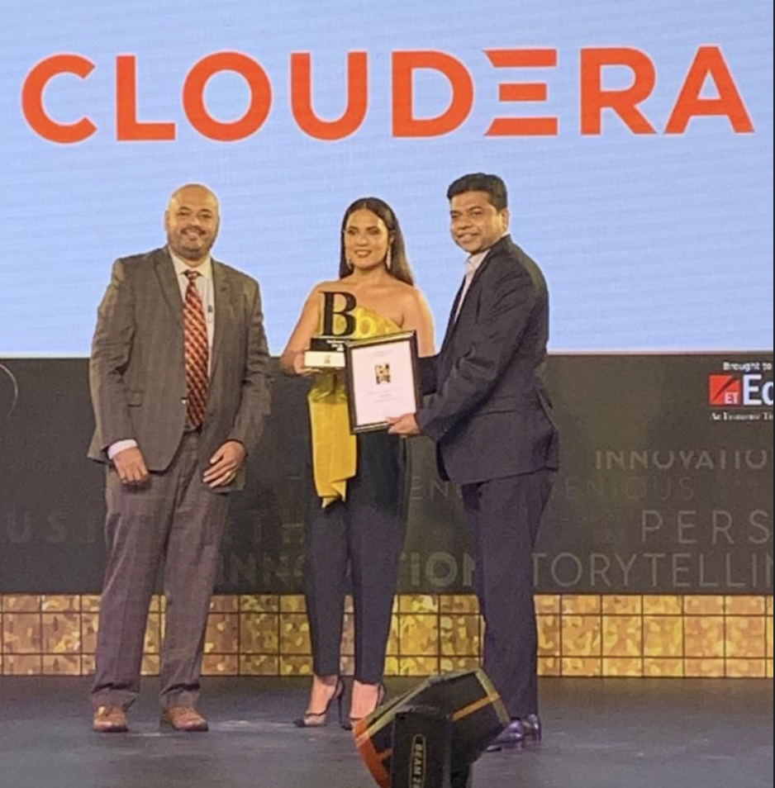
Economic Times Best Brand Award - 2021
Cloudera was recognized amongst the top brands for our:
Innovation
Brand Value
Brand Recall
Customer Satisfaction
Customer Service
Quality

Slide 6
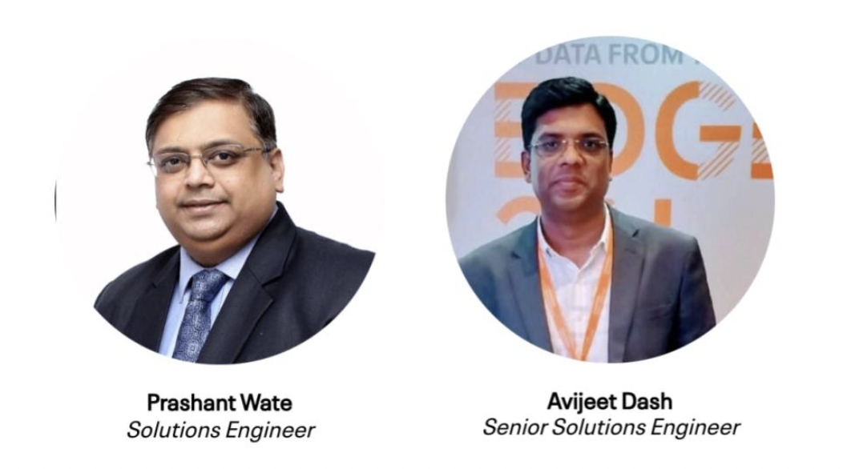
MEET THE CLOUDERA TEAM

Slide 7
CDP TEST DRIVE WORKSHOP AGENDA
10:00am - 10:05am | Welcome & Introductions
10:05am - 10:45am | CDP Public Cloud Overview Data Catalog Lab
10:45am - 11:15am | Cloudera Data Warehouse Overview, Benefits & CDW Labs
11:15am - 11:45am | Cloudera Machine Learning Overview & Benefits
11:45am - 12:00pm | Q&A / Wrap Up

Slide 8
CLOUDERA DATA PLATFORM
CDP PUBLIC CLOUD

Slide 9
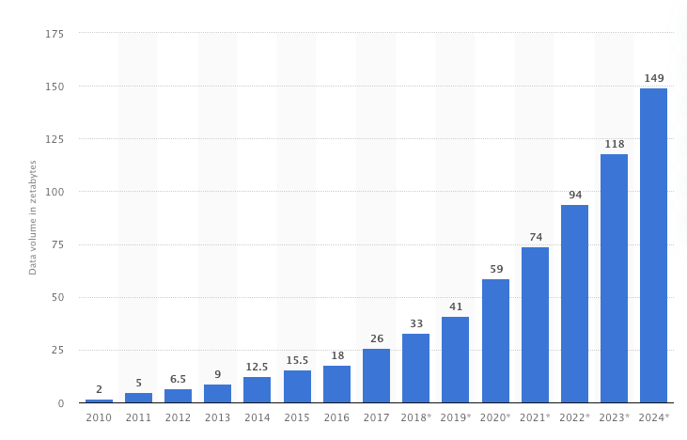
THERE IS DATA STORM AHEAD - ARE ENTERPRISES READY?
Volume Of Data Created Worldwide 2010 - 2024
Figures from 2021 - 2024 were calculated by Statista based on 2020 figure and the five year compound annual growth rate of 26 percent. Prior figures based on IDC forecast from late 2018. https://www.statista.com/statistics/871513/worldwide-data-created/

Slide 10
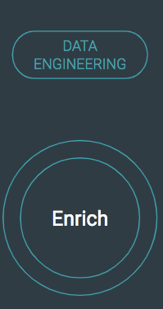
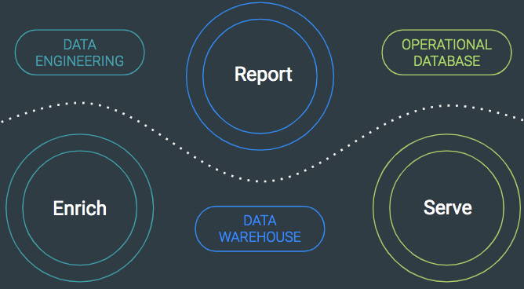
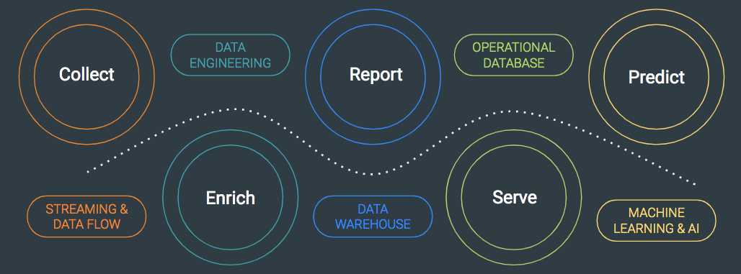
EXPANDING VARIETY OF DATA AND WORKLOAD TYPES
2010
2015
2020
70%
Data
50%
45%
30%
25%
25%
20%
20%
10%
5%
Raw
Refined
Raw
Refined
Transactional
Raw
Refined
Transactional
Optimized
Derived
Data
Workloads
Notes:
One important trend we are seeing within this data storm is that the data applications and use cases that business are creating has evolved and diversified considerably over the last decade.
Ten years ago, the world of big data was much simpler. Users at the time were looking to create their company’s first data lake and their primary challenge was collecting that data into a central location and transforming it into a useful format. The applications they built at the time were relatively simple Data Engineering workloads that served to filter and enrich the data.
A few years later, these users had succeeded in building out a central data lake, but now they also needed to extract business value from the data. In particular, Business Analysts wanted to run SQL on top of the data lake and they created Data Warehousing applications to generate reports and support ad hoc SQL analysis. Additionally, we saw Developers create Operational Databases to serve data into their online applications. This demand consequently expanded the variety of workloads that their data platforms needed to support.
In the last few years, this trend of expanding use cases and workloads has continued. Streaming engineers have reduced insight latency by refactoring the data ingestion pipelines. DBAs have improved performance by refactoring their data warehouses to leverage materialized views, aggregates, and cubes. And Data Scientists have created predictive models to take action on detected patterns.

Slide 11
THE DATA LIFECYCLE
Customers need to manage and secure the data lifecycle in any cloud or datacenter
DATA ENGINEERING
OPERATIONAL DATABASE
Collect
Report
Predict
02
04
01
03
05
Enrich
Serve
STREAMING & DATA FLOW
DATA WAREHOUSE
MACHINE LEARNING & AI
SECURITY | GOVERNANCE | LINEAGE | MANAGEMENT | AUTOMATION
Notes:
By enabling customers to get control of data – across the entire data and analytics lifecycle…
[other vendors support some functions but not all, or not their offerings are not integrated to work together easily, so they perpetuate data and organizational silos]
[NOTE] two competitive slides in back-up….can be used depending on audience.
We not only support all, but do it in an integrated fashion…from collection to prediction…making it possible to secure and govern, manage and automate the entire process.
This enables Enterprise IT to do better than Shadow IT, and deliver services people want to use…to drive insights from data…
It’s what we call an Enterprise Data Cloud…cloud services to manage and secure the data lifecycle in any cloud or data center…
It’s what you need to drive the most valuable business use cases…[CLICK]
[NOTE] This slide is intentionally simple and does not reflect the fact that
1) the lifecycle is continuous and circles back from prediction to collect and repeats.
2) our products operate across the lifecycle, as well as in the “vertical” functions shown.
It is most important to get across that mastering the data lifecycle is fundamental for organizations to become data-driven. If you don’t, you won’t.
If you don’t master the lifecycle, you won’t get data insights that improve productivity and transformation. You will get stuck at basic visibility advancements (seeing what’s happening in your business, but not able to do anything about it, because the data is fragmented and you can’t see the interconnectedness (think predictive maintenance or assisted driving)
Other vendors are solving point problems, we are solving the lifecycle problem for customers, and the point problems.
NOTE, we also don’t lead with cloud - it is mentioned in the subtitle - not the diagram.
That’s because getting control of data (data strategy) is job one; a cloud strategy is secondary and supportive of job one.
Pay attention to the sub-title - it is a very simple way to describe “what” we do...you will see it alot thru the deck.

Slide 12

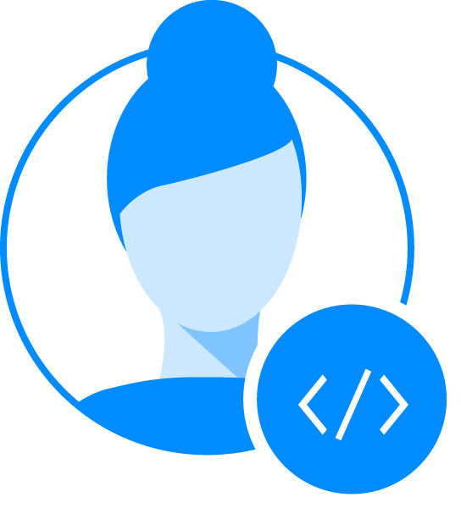
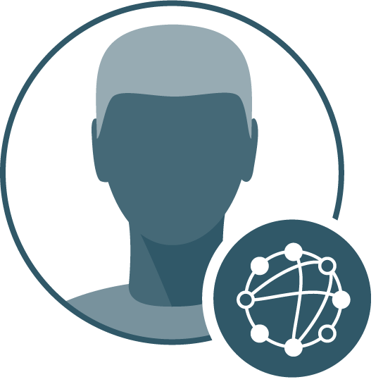
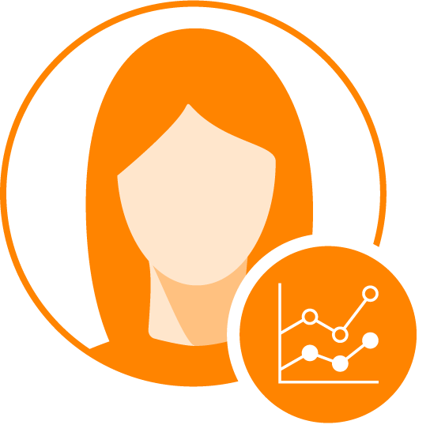

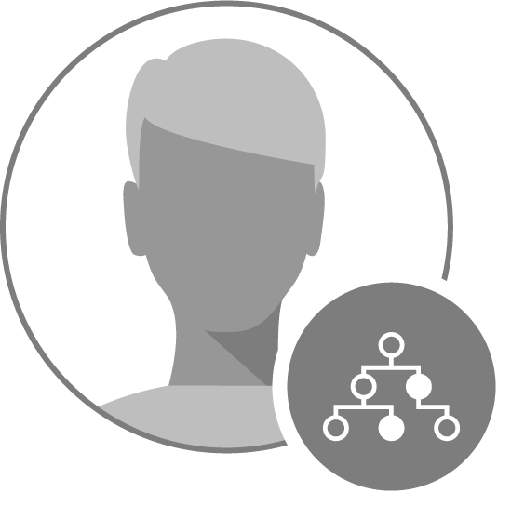

EACH PART OF DATA LIFE CYCLE INTRODUCES NEW PERSONAS
Data Engineers
BI Analysts
Data Scientists
App Developers
Capacity guarantees to enable consist SLAs
Capacity on demand to support bursty workloads
Latest tools and hardware, unpredictable capacity
Continuous availability, custom tooling
Data Architects
Infrastructure Mgrs.
Compliance Mgrs.
Single-source-of-truth
Reliability, cost, & scale
Privacy and verifiable audit

Slide 13
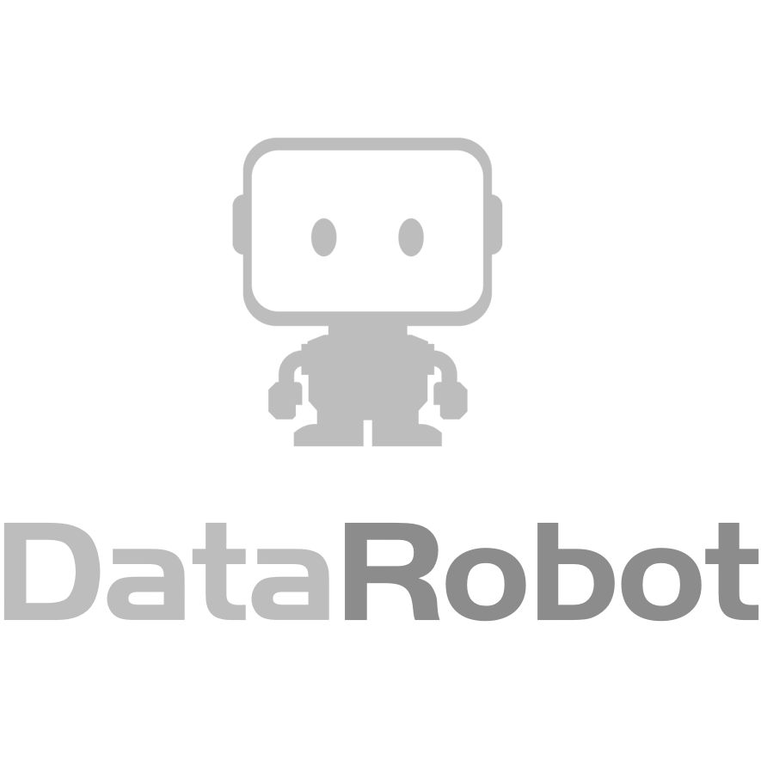
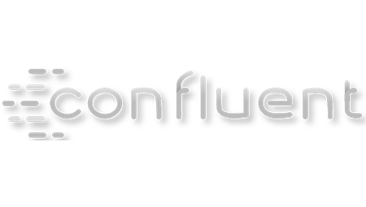


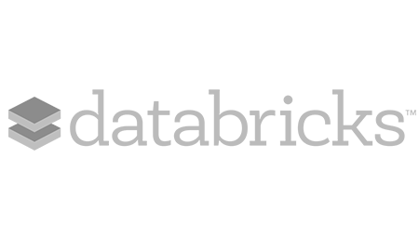
POINT SOLUTIONS HAVE AN INTEGRATION TAX
Integration
Tax
Integration
Tax
Integration
Tax
Integration
Tax
DATA ENGINEERING
OPERATIONAL DATABASE
02
04
01
03
05
STREAMING & DATA FLOW
DATA WAREHOUSE
MACHINE LEARNING & AI
SECURITY | GOVERNANCE | LINEAGE | MANAGEMENT | AUTOMATION
Notes:
We manage, secure and automate the complete data and analytics lifecycle in any cloud or datacenter...

Slide 14



A NEW KIND OF PLATFORM EXPERIENCE IS NEEDED
CUSTOM ENVIRONMENTS
CUSTOM ENVIRONMENTS
CUSTOM ENVIRONMENTS
CUSTOM ENVIRONMENTS
App Developers
Data Engineers
BI Analysts
Data Scientists
Centralized Data, Security, Governance and Management
Compliance Mgrs.
Data Architects
Infrastructure Mgrs.

Slide 15
Architecture

Slide 16
UNDERPINNING DESIGN PRINCIPLES REMAIN THE SAME
DISAGGREGATED SOFTWARE STACK
EXTREMELY LARGE-SCALE
OPEN SOURCE
EVOLVING ECOSYSTEM
Storage +
Compute +
Security +
Governance +
SQL, DE, DF, ML
Distributed systems
Commodity infrastructure, hardware & cloud
Open data standards
Community scale
Diverse technologies
Innovation at every layer, independently

Slide 17
THE TECHNOLOGY SHIFTS HAVE EVOLVED THE ARCHITECTURE
CLOUD
COMPUTE & STORAGE
KUBERNETES
& CONTAINERS
STREAMING & ML/AI
Easy to use, self-service, on-demand, elastic, consumption
Separation in public and private clouds for increased performance
Adoption as standard operating environment for flexibility and agility
Multi-function analytics for the data-driven enterprise
Notes:
Our teams have been seeing & contributing to these major architecture and technology shifts
Cloud experience of on-demand, elasticity, ease of use, consumption expected
Adoption of Kubernetes and Containers as standard operating environment for added flexibility and agility
Separation of compute and storage for increased performance
Introduction of real-time streaming and ML/AI for the Data Driven Enterprise

Slide 18





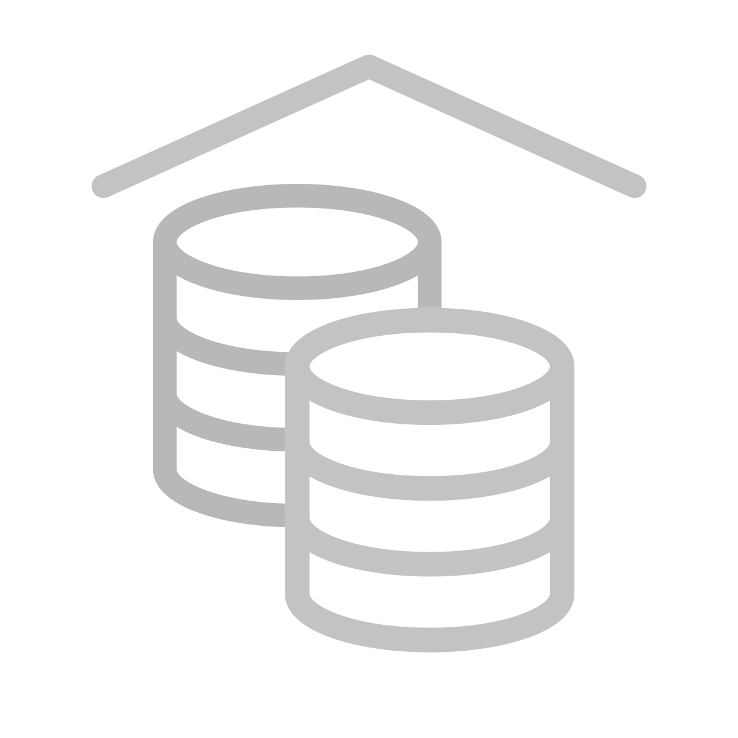
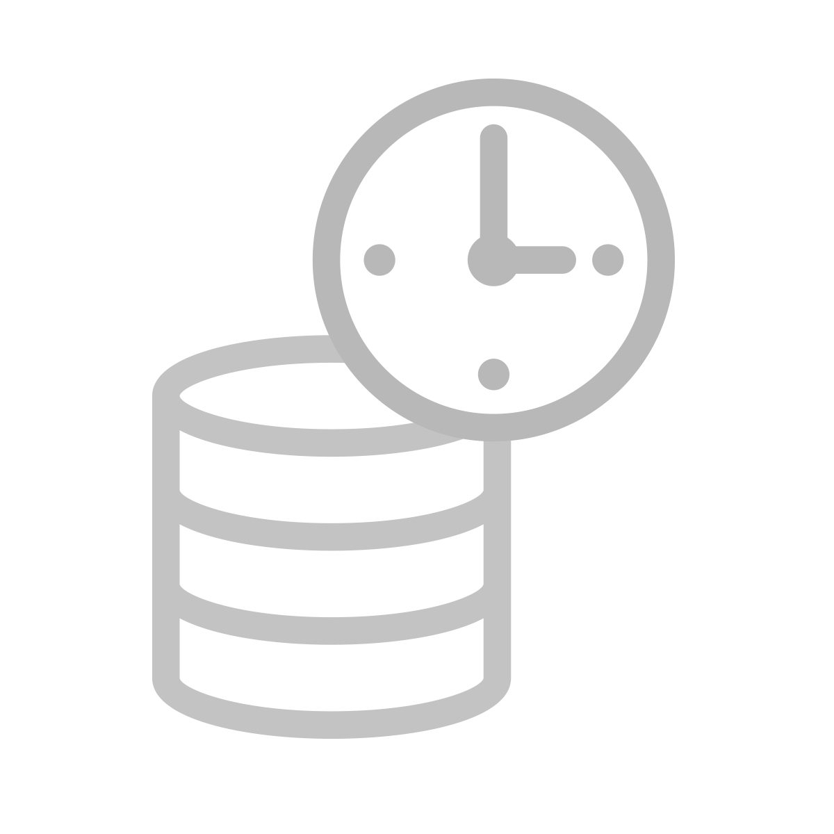

WE CALL IT THE “ENTERPRISE DATA CLOUD”
Any Tier | All Data
Data Lifecycle
Secure & Governed
Open + Standards
Multiple public
Hybrid
Private
Data center
Edge
Streaming
Data engineering
Data warehousing
Machine learning & AI
Data & metadata
Fine grained security
Lineage and provenance
Data & workload migration
100% Open source
Open data formats
Open storage & compute
Open APIs

Slide 19

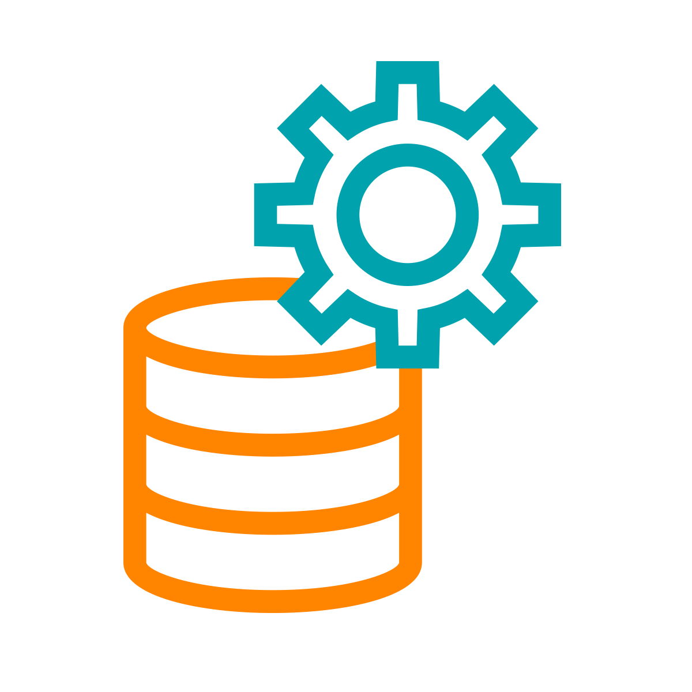
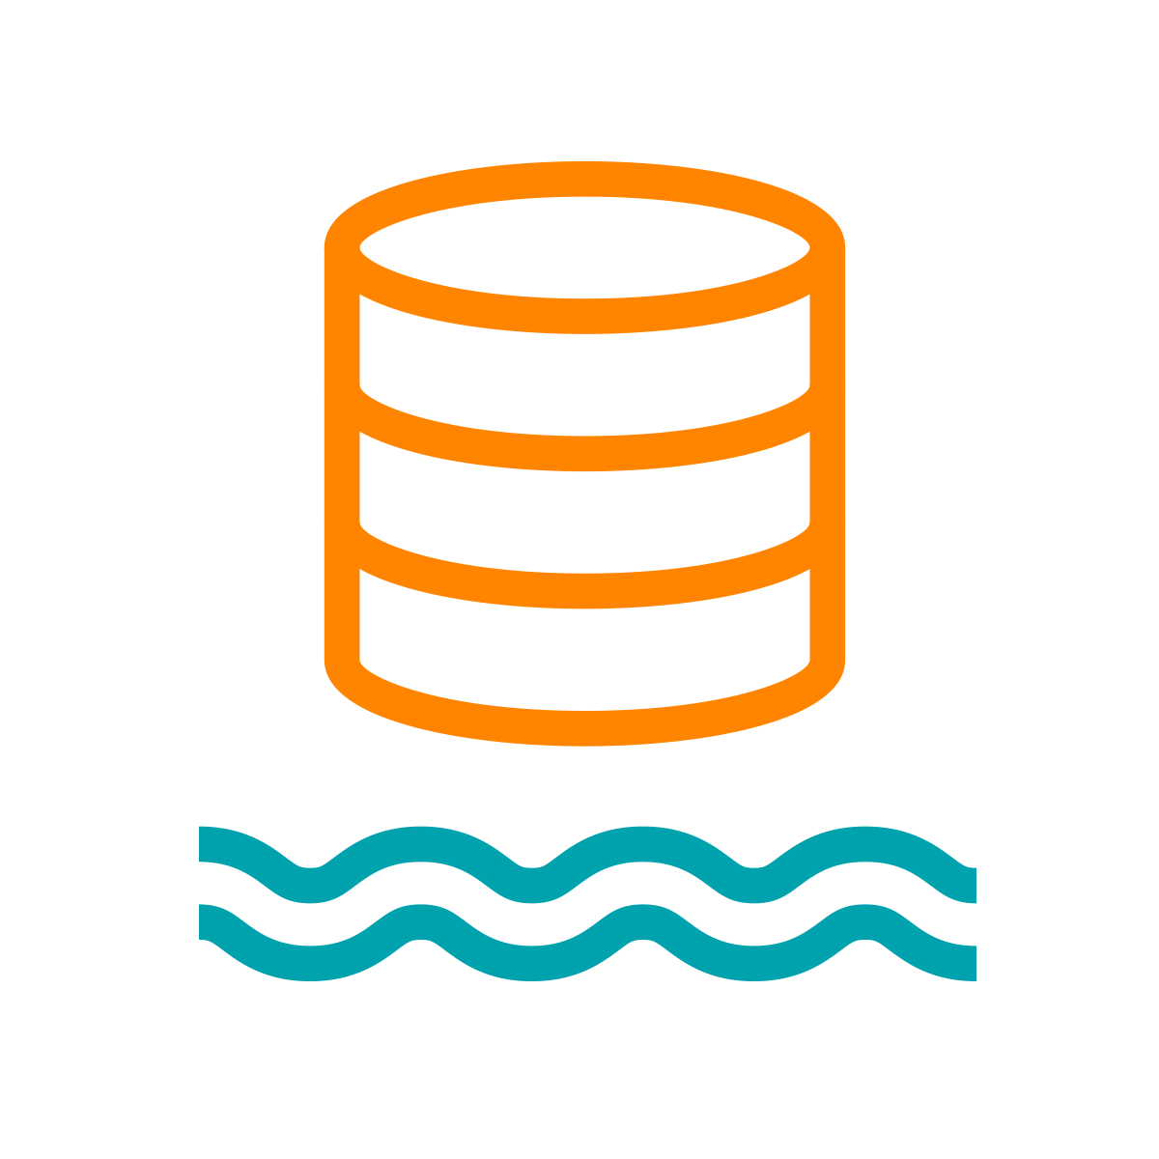
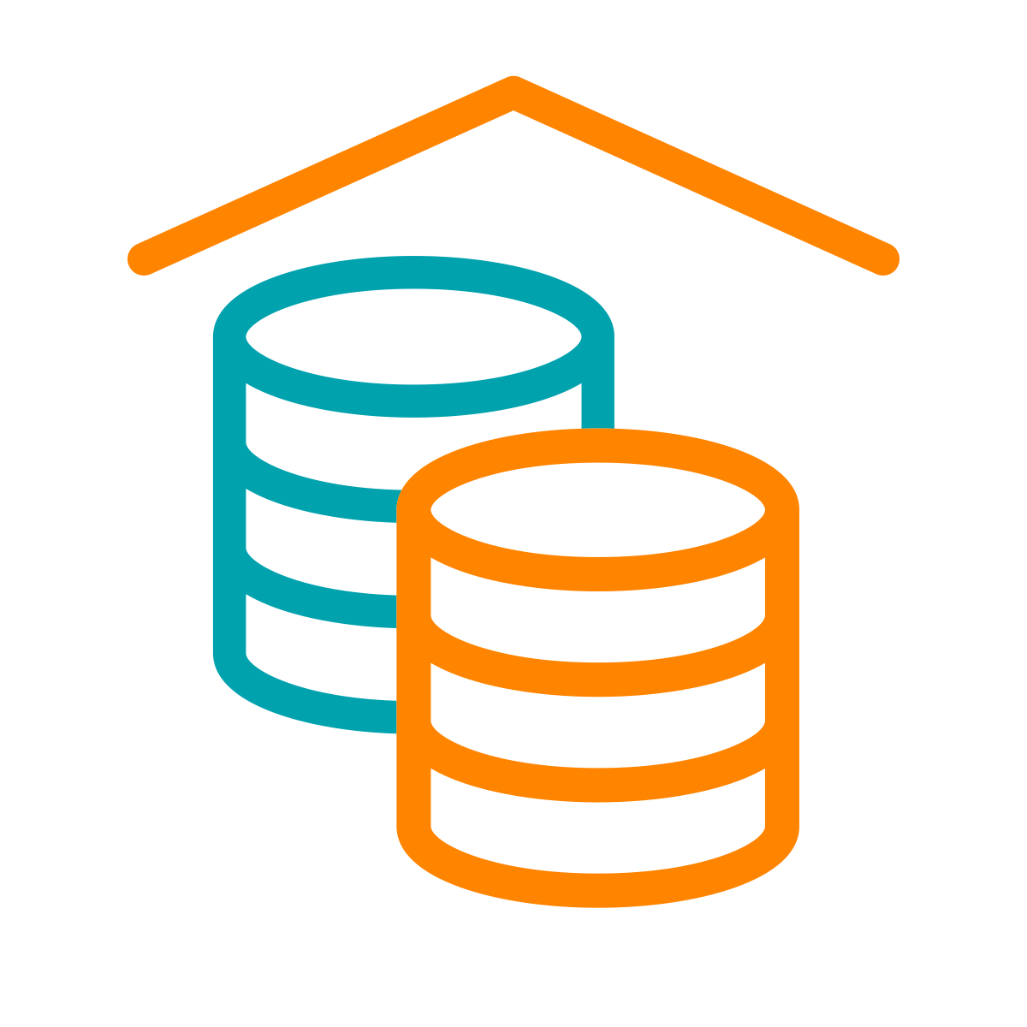
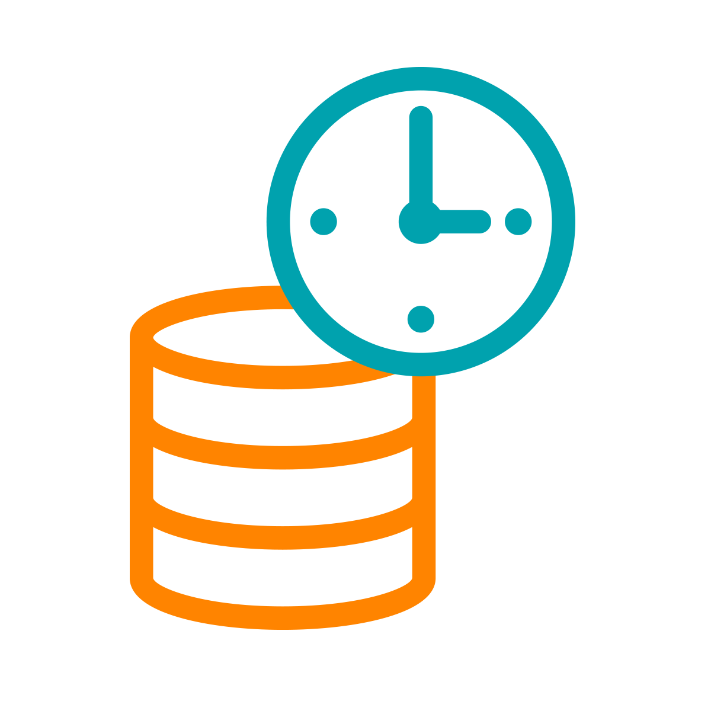

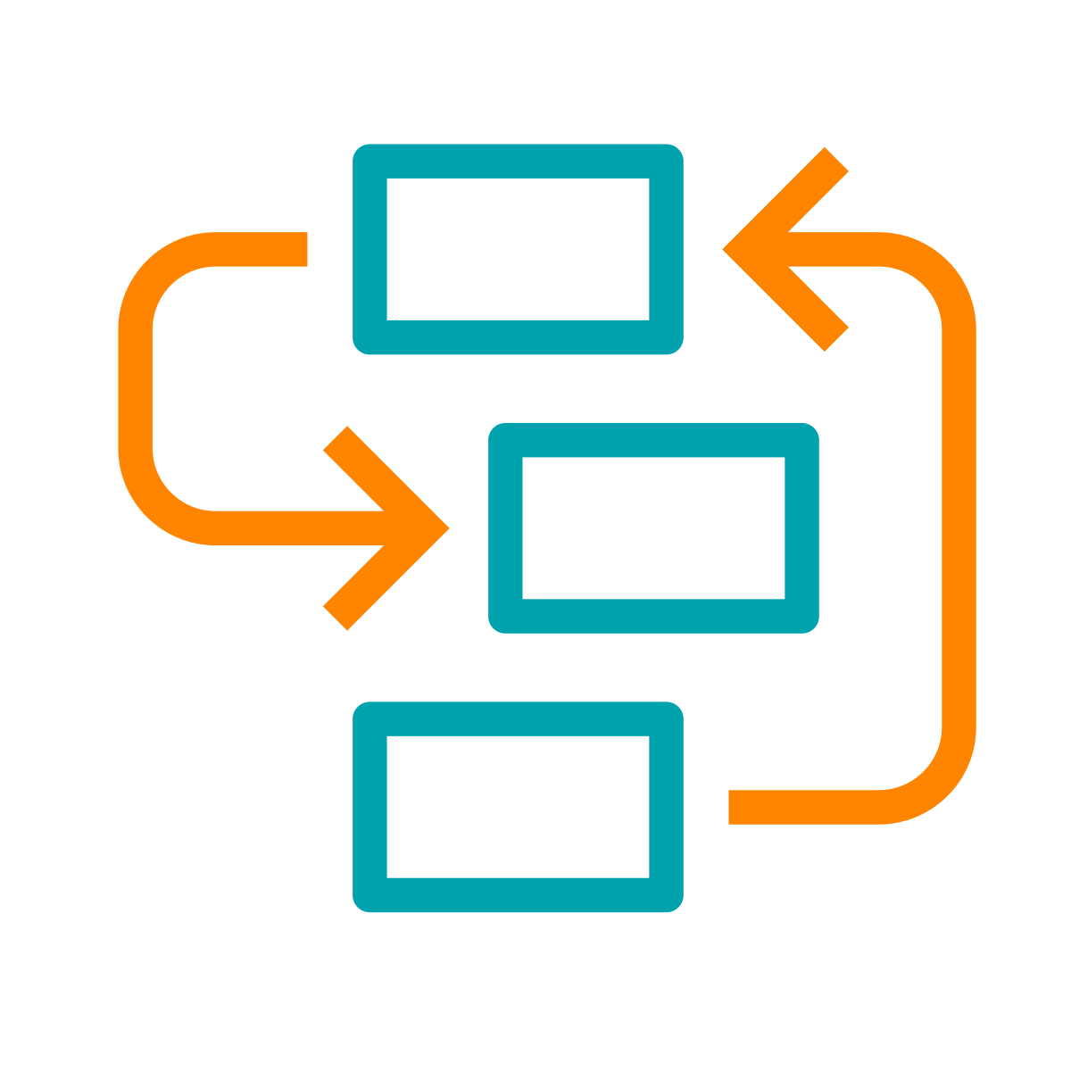
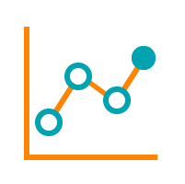
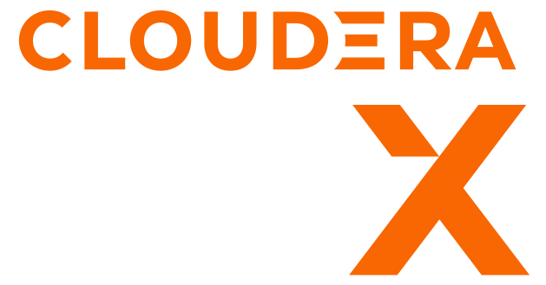








A HYBRID / MULTI-CLOUD DATA PLATFORM AND AN INTEGRATED SUITE OF SECURE ANALYTIC APPS
Real-time
Batch
Structured
Unstructured
Data Collection
Data
Engineering
Virtual Data Lake
Data Warehouse
Operational Database
Streaming Analytics
Machine Learning
Data Visualization
Analysts
Engineers
Scientists
Developers
Data Sources
Data Users
Cloudera Data Platform
Data Lifecycle integration for better user productivity and faster time to value
Hybrid & Multi-Cloud to leverage existing investments and reduce risk
Secure & Governed to simplify data protection, sharing and compliance
Open & Extensible to support more use cases faster and at lower cost

Slide 20
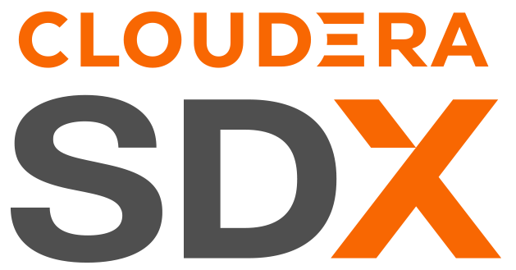
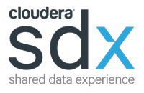
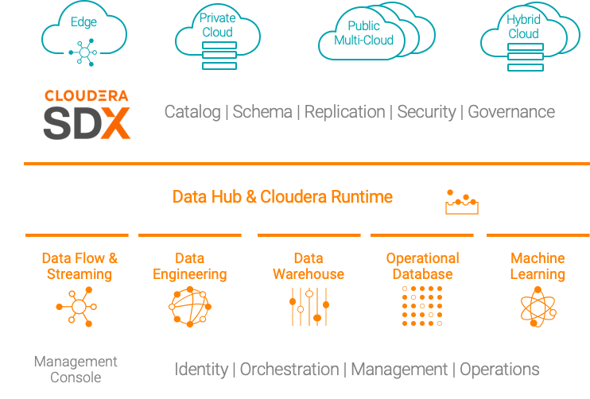
CONSISTENT SECURITY AND GOVERNANCE
Built for multi-functional analytics anywhere
Data Catalog: a comprehensive catalog of all data sets, spanning on-premises, cloud object stores, structured, unstructured, and semi-structured
Schema: automatic capture and storage of any and all schema and metadata definitions as they are used and created by platform workloads
Replication: deliver data as well as data policies there where the enterprise needs to work, with complete consistency and security
Security: role-based access control applied consistently across the platform. Includes full stack encryption and key management
Governance: enterprise-grade auditing, lineage, and governance capabilities applied across the platform with rich extensibility for partner integrations
Notes:
And SDX does just that as a critical and differentiating platform capability
Consistent security and governance as well as schema and data catalog service
So you can deploy to any infrastructure

Slide 21
E2E SECURITY & GOVERNANCE
SDX minimises data governance and security risk
CLOUDERA: SDX ENBALES SEPARATION OF CONTEXT
OTHER CLOUD & POINT SOLUTIONS
Monocluster
Architecture
Cloud-based Cluster
Architecture
Cloud-native Hybrid Data Architecture
Security and governance is an “after thought”, e.g. no fine-grained security or data lineage
Physical Servers
Virtual Machines
Virtual Machines
COMPUTE
COMPUTE
COMPUTE
Always-on-Service
Additional 3P tools required to enable fine-grained security and e2e data governance
CONTEXT
CONTEXT
Object Storage
Object Storage
STORAGE
STORAGE
STORAGE
Higher operational risk:
Solution complexity
Integration challenges
Additional cost of 3P tools
Always-on Context – Metadata, metrics, audit, lineage, permissions, filters, attributes – promotes discoverability, trust, compliance, reusability, and security

Slide 22
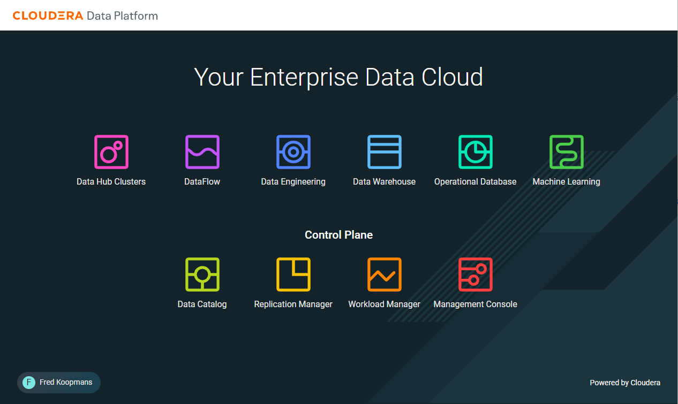

Slide 23
POINT SOLUTIONS HAVE AN INTEGRATION TAX
Integration
Tax
Integration
Tax
Integration
Tax
Integration
Tax
DATA ENGINEERING
OPERATIONAL DATABASE
02
04
01
03
05
STREAMING & DATA FLOW
DATA WAREHOUSE
MACHINE LEARNING & AI
SECURITY | GOVERNANCE | LINEAGE | MANAGEMENT | AUTOMATION
Notes:
We manage, secure and automate the complete data and analytics lifecycle in any cloud or datacenter...

Slide 24

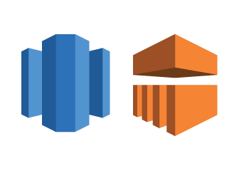

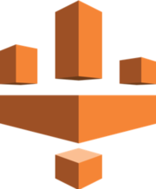
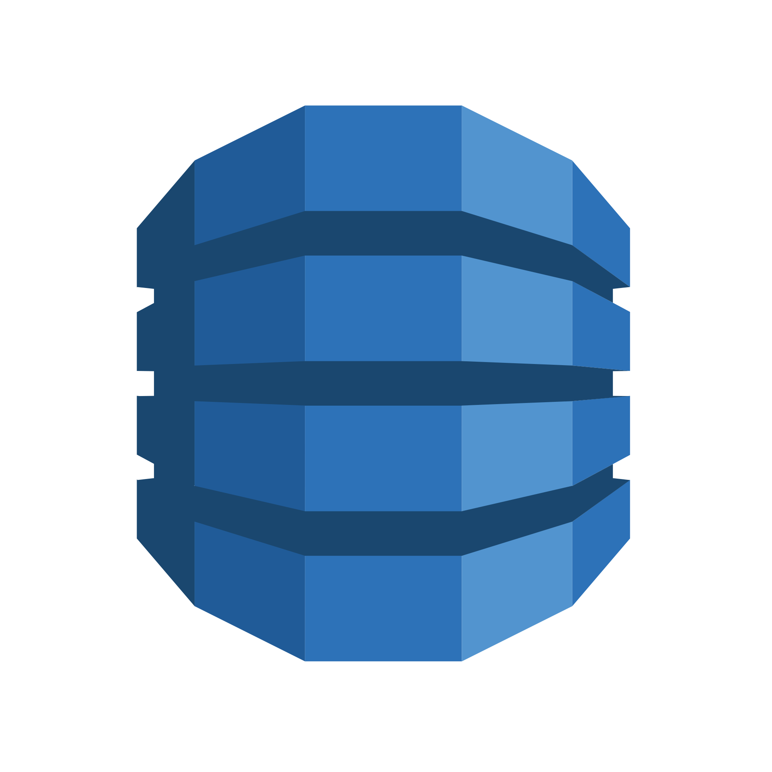
POINT SOLUTIONS FROM AWS
Basic security, limited integration and zero automation
Integration
Tax
Integration
Tax
Integration
Tax
Integration
Tax
DATA ENGINEERING
OPERATIONAL DATABASE
Kinesis
02
Redshift
04
Sagemaker
01
Glue
Glue
03
Glue
Glue
05
Lake Formation
Lake Formation
Lake Formation
Lake Formation
STREAMING & DATA FLOW
DATA WAREHOUSE
DynamoDB
MACHINE LEARNING & AI
EMR
CloudTrail
CloudWatch
CloudTrail
CloudWatch
SECURITY | GOVERNANCE | LINEAGE | MANAGEMENT | AUTOMATION

Slide 25



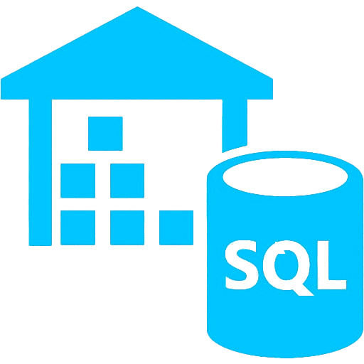
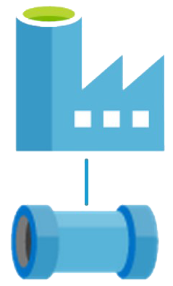
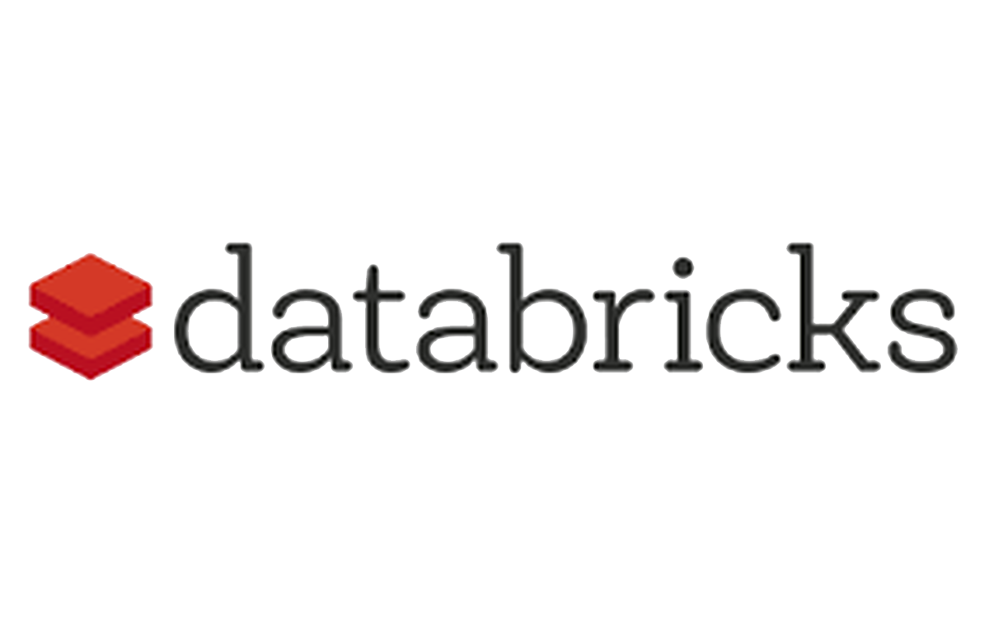

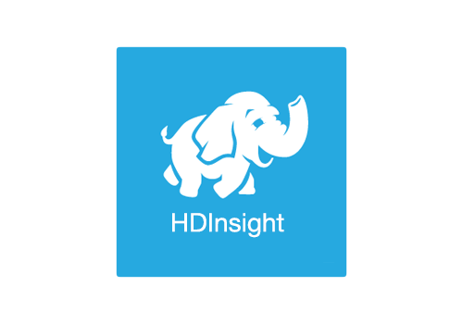
POINT SOLUTIONS FROM AZURE
Basic security, limited integration and zero automation
Integration
Tax
Integration
Tax
Integration
Tax
Integration
Tax
DATA ENGINEERING
OPERATIONAL DATABASE
Data Factory
Streaming Analytics
Azure ML
02
SQL Data Warehouse
04
Pipeline
Pipeline
Pipeline
Pipeline
01
03
05
STREAMING & DATA FLOW
DATA WAREHOUSE
Cosmos DB
MACHINE LEARNING & AI
SECURITY | GOVERNANCE | LINEAGE | MANAGEMENT | AUTOMATION

Slide 26
Getting Started & Hands-on
SDX - Data Catalog product overview and lab
https://github.com/pwate/cdptestdrive/blob/main/Data_Catalog.pdf
https://github.com/pwate/cdptestdrive

Slide 27
CDP DATA CATALOG
TEST DRIVE GUIDED TOUR

Slide 28
CDP DATA CATALOG
GUIDED TOUR - WALK-THROUGH
Open CDP, using the “admin” user within the Test Drive link.
Click the link in your email. Your link looks like this:
http://login.trycdp.com/auth/realms/trycdp-trialxx/protocol/saml/clients/samlclient?tn=trialxx_admin@trycdp.com&p=X
*xx represents the trial user #
*X represents the password

Slide 29
Wrap Up

Slide 30
NEXT STEPS
Sign-up to your own 48 hour Test Drive experience
On-demand recording of this workshop and post-event survey will be emailed to you by end of day
Try CDP Public Cloud for free for 60-days using your own data and workloads! Click here to get your trial started.

Slide 31
THANK YOU

